Slide 1
Sexual Reproduction in animals

Slide 2
By the end of this Lesson you should be able to:
1. | Explain what sexual reproduction is.
2. | State what external fertilisation is.
3. | State what internal fertilisation is.

Slide 3
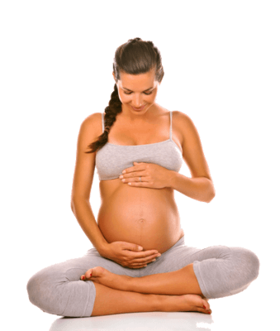
Sexual Reproduction
In animals, sexual reproduction involves the fusion of two distinct gametes to form a zygote.
In almost all mammals, the offspring develop within the parent; this process requires specific organs. You will learn about these organs in the next module.

Slide 4
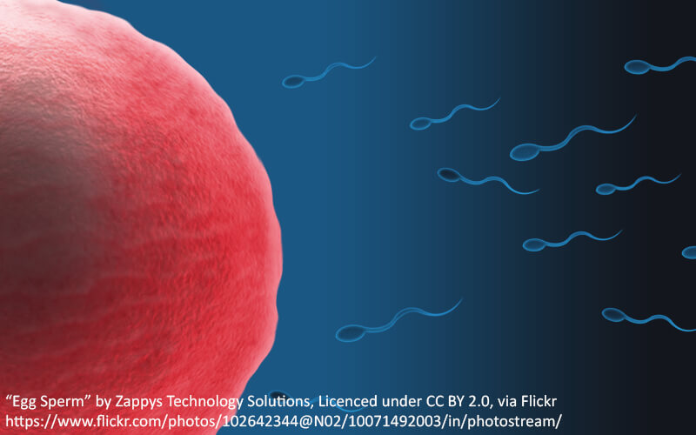
Sexual Reproduction II
Sexual reproduction requires male and female gametes.
Male gametes are called sperm, and female gametes are called eggs, or ova.

Slide 5
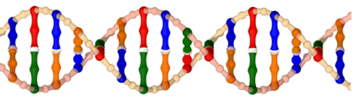
Goal of Sexual Reproduction
The goal of sexual reproduction is for a species to pass their genes onto their offspring.
This ensures the survival of the species.

Slide 6

External fertilisation
As the name suggests, external fertilisation takes place outside the body. Most aquatic organisms have this characteristic.

Slide 7
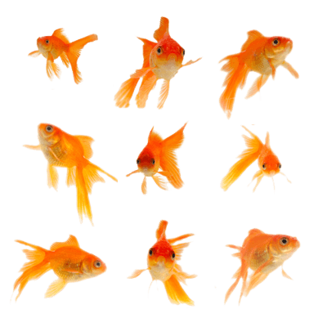
External Fertilisation II
Gametes are shed directly into the water. Fertilisation occurs and the fertilised eggs develop, according to that organism's life cycle, into adults.

Slide 8

External Fertilisation III
It involves little energy investment from parents, but due to a low success rate, often millions of gametes have to be produced to ensure fertilisation will occur.

Slide 9
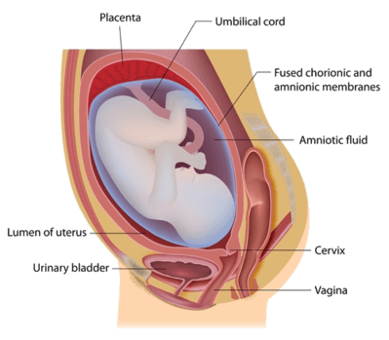
Internal Fertilisation
Unlike external fertilisation, internal fertilisation occurs inside the body of the female in animals, or in the female part of the plant in sexually reproducing plants.
Don't worry about the labels on the image below, you will learn about these in the next module. Just notice that a baby is growing INSIDE the body.

Slide 10
Internal fertilisation II
Internal fertilisation is a characteristic of most land organisms.
It requires a large investment from parents, particularly the mother.
After fertilisation, further development of the new organism requires water for survival.

